Slide 1
Monte Carlo simulation of a correlated credit counterparty risk in R
Dr Grzegorz Goryl PRM
grzegorz@goryl.eu

Slide 2
Outline
Intro to basic finance
Briefly about implementation
Some results

Slide 3
Bond
A bond is a debt investment in which an investor loans money to an entity (typically corporate or governmental) which borrows the funds for a defined period of time at a variable or fixed interest rate.
Zero-coupon bond
Coupon bond
N
0
T
P
N
C
C
C
C
C
0
T
P

Slide 4
CDS
A credit default swap is a particular type of swap designed to transfer the credit exposure between two parties. In a credit default swap, the buyer of the swap makes payments to the swap’s seller up until the maturity date of a contract. Payments are agreed as percentage of notional. In return, the seller agrees that, in the event that the debt issuer defaults or experiences another credit event, the seller will pay the buyer lost percentage of debt during the default.
1-R
0
τ
T
s
s
s
s
s
s
s
s
s
s
s
s

Slide 5
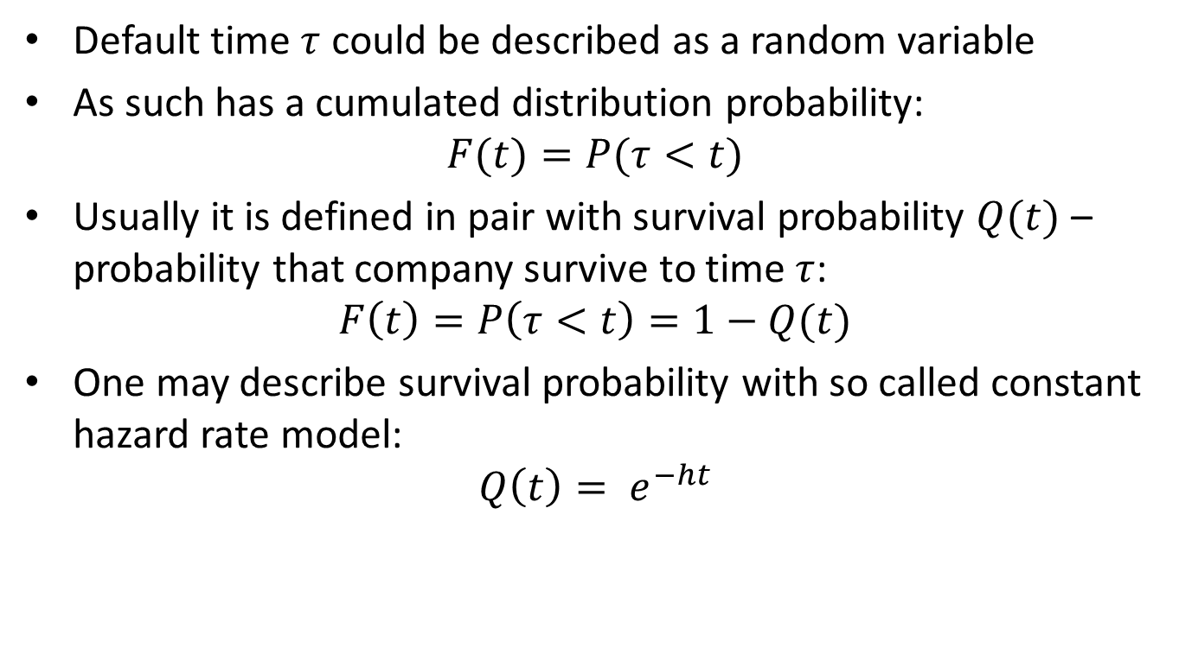
Default time
Default time $τ$ could be described as a random variable
As such has a cumulated distribution probability:
$$F(t)=P(τ<t)$$
Usually it is defined in pair with survival probability $Q(t)$ – probability that company survive to time $τ$:
$$F\left(t\right)=P\left(τ<t\right)=1−Q(t)$$
One may describe survival probability with so called constant hazard rate model:
$$Q\left(t\right)= e^{−ht}$$

Slide 6
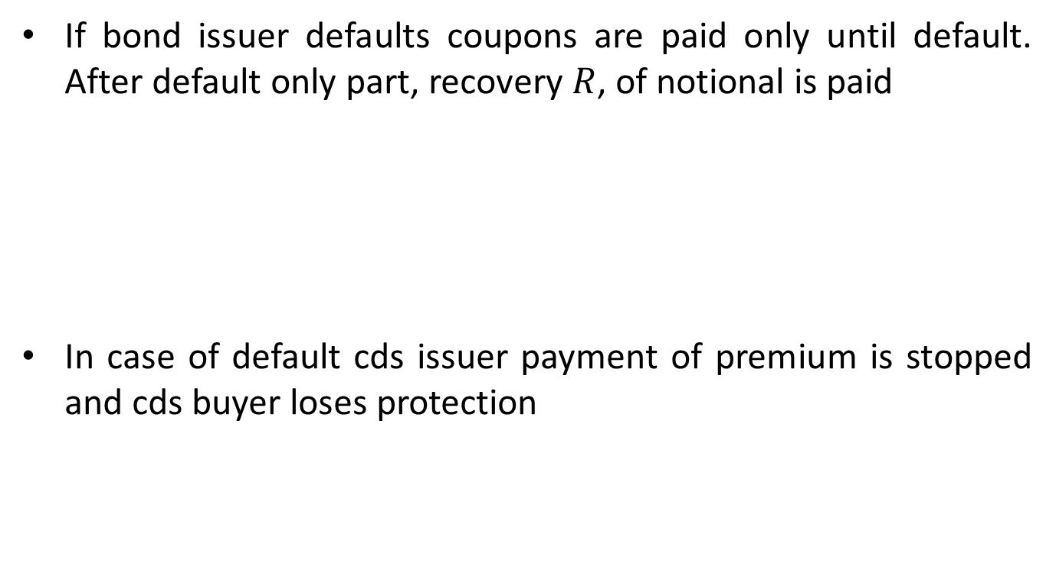
Risky bond and risky CDS
If bond issuer defaults coupons are paid only until default. After default only part, recovery $R$, of notional is paid
In case of default cds issuer payment of premium is stopped and cds buyer loses protection
N
RN
C
C
C
C
C
C
C
C
C
C
C
C
0
τ₁
T
1-R
0
τ₂
τ₁
T
s
s
s
s
s
s
s
s
s
s
s
s

Slide 7
CVA
Credit valuation adjustment (CVA) is the difference between the risk-free portfolio value and the true portfolio value that takes into account the possibility of a counterparty’s default. In other words, CVA is the market value of counterparty credit risk.

Slide 8
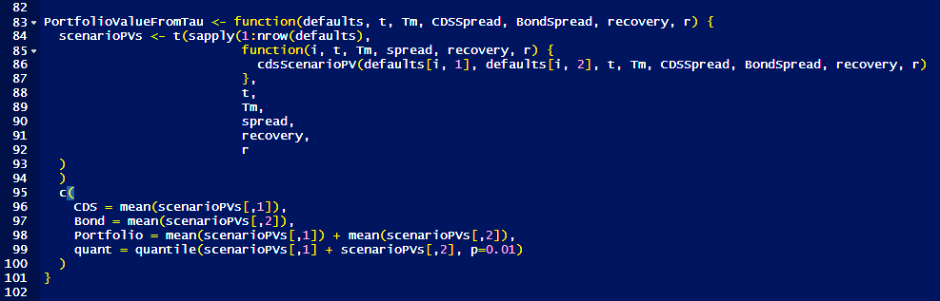
Portfolio Valuation with MC
In many cases it is not possible to have closed formula for value of portfolio. In such situation Monte Carlo simulations is applied.
One simulates many scenarios, and then average value from scenarios is calculated, or other statistics.

Slide 9
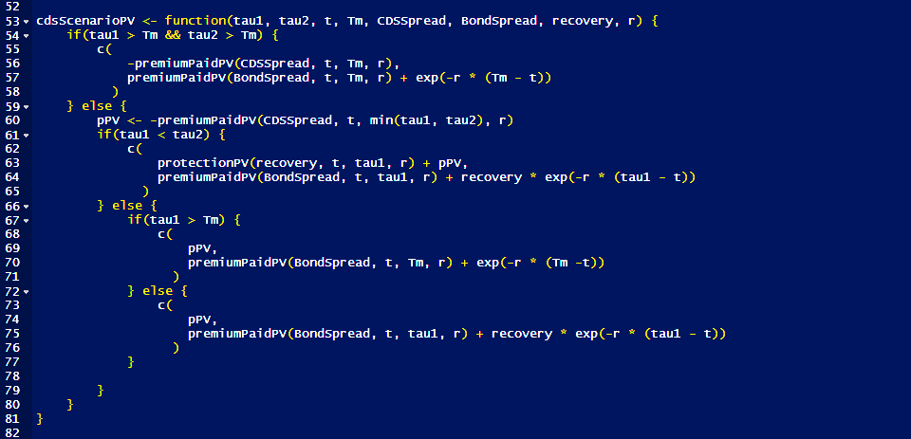
Single scenario

Slide 10


Correlated default times
A copula is a multivariate probability distribution for which the marginal probability distribution of each variable is uniform.
Gaussian copula
$C\left(x_{1},x_{2}\right)=Φ_{2}\left(Φ^{−1}(x1),Φ^{−1}(x2)\right)$

Slide 11
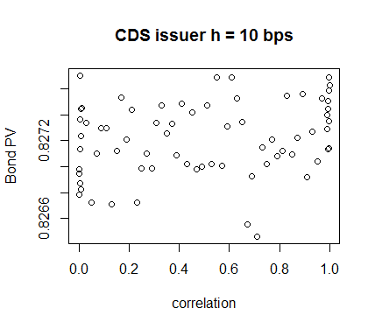
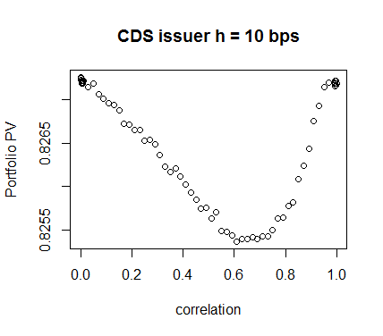
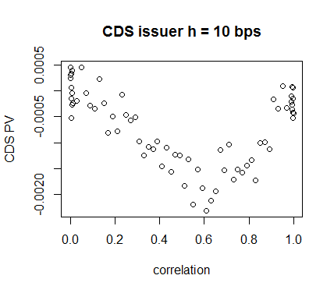
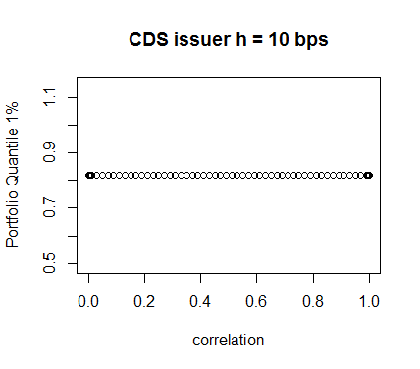
Results for cds issuer h=10 bps

Slide 12
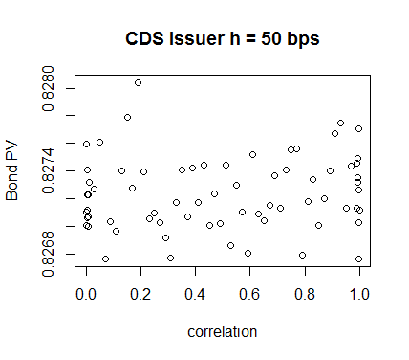
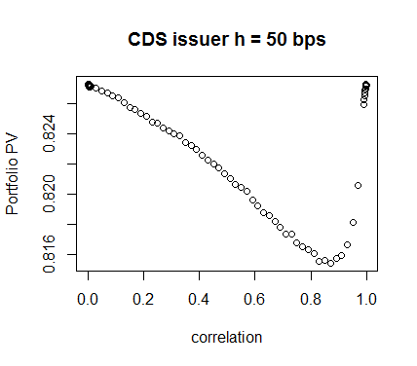
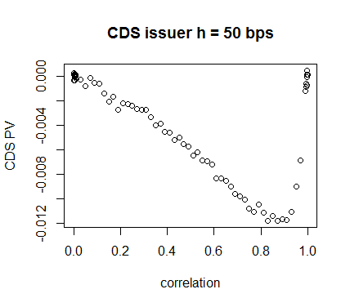
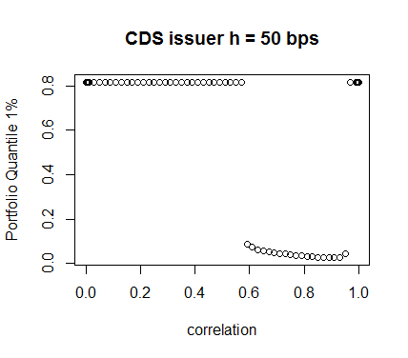
Results for cds issuer h=50 bps

Slide 13
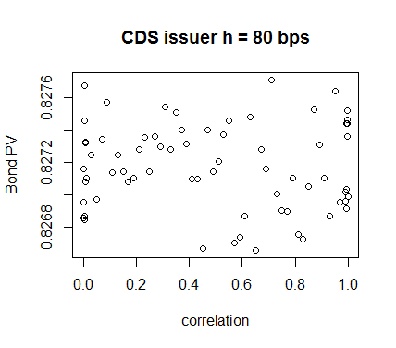
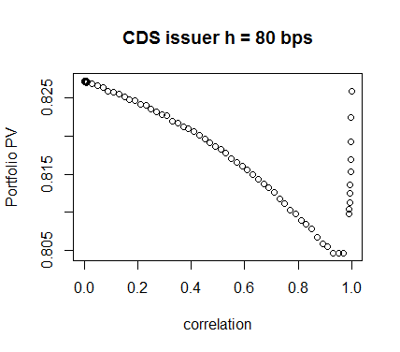
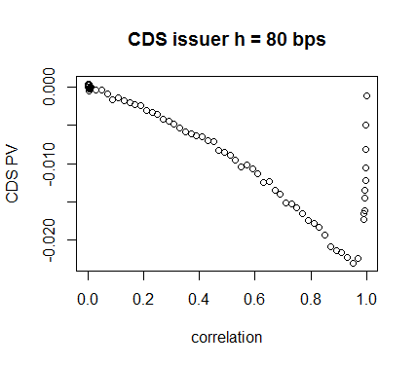
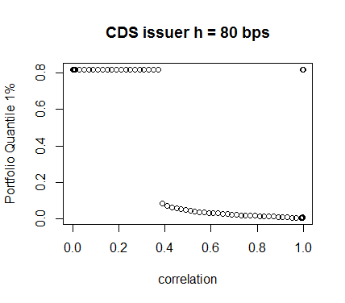
Results for cds issuer h=80 bps

Slide 14
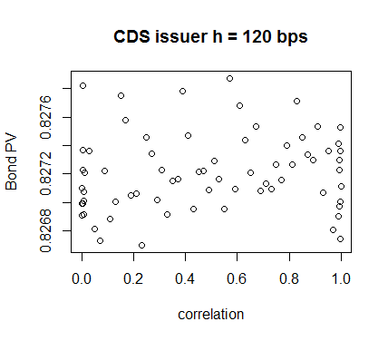
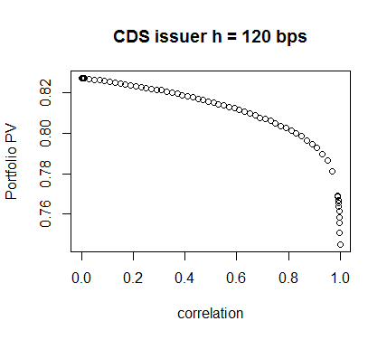
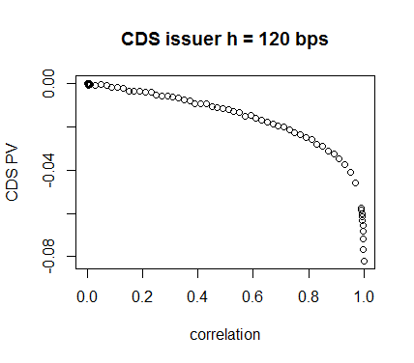
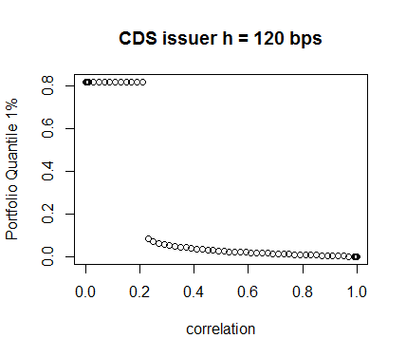
Results for cds issuer h=120 bps

Slide 15
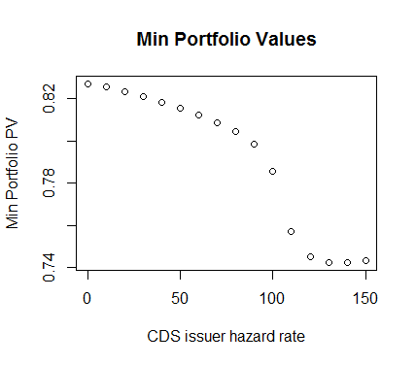
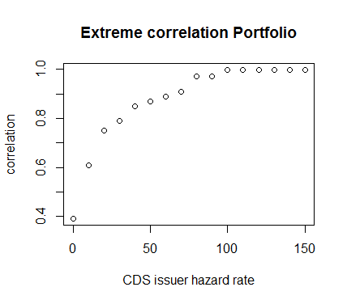
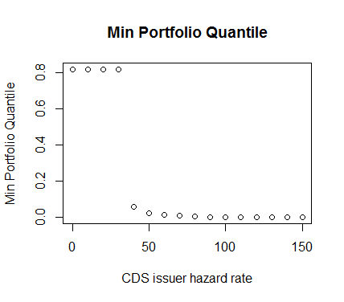
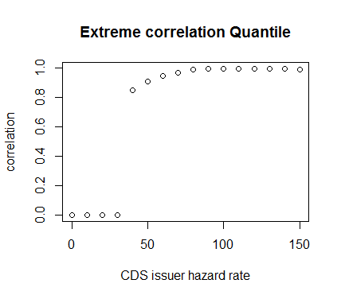
Results for bond issuer h=100 bps

Slide 16
Conclusions
Non-trivial behavior of portfolio value even consisting of simple financial instruments when correlation is included
R could be used to quite fast simulate and analyze recent issues to be solved by financial industry

